Slide 1

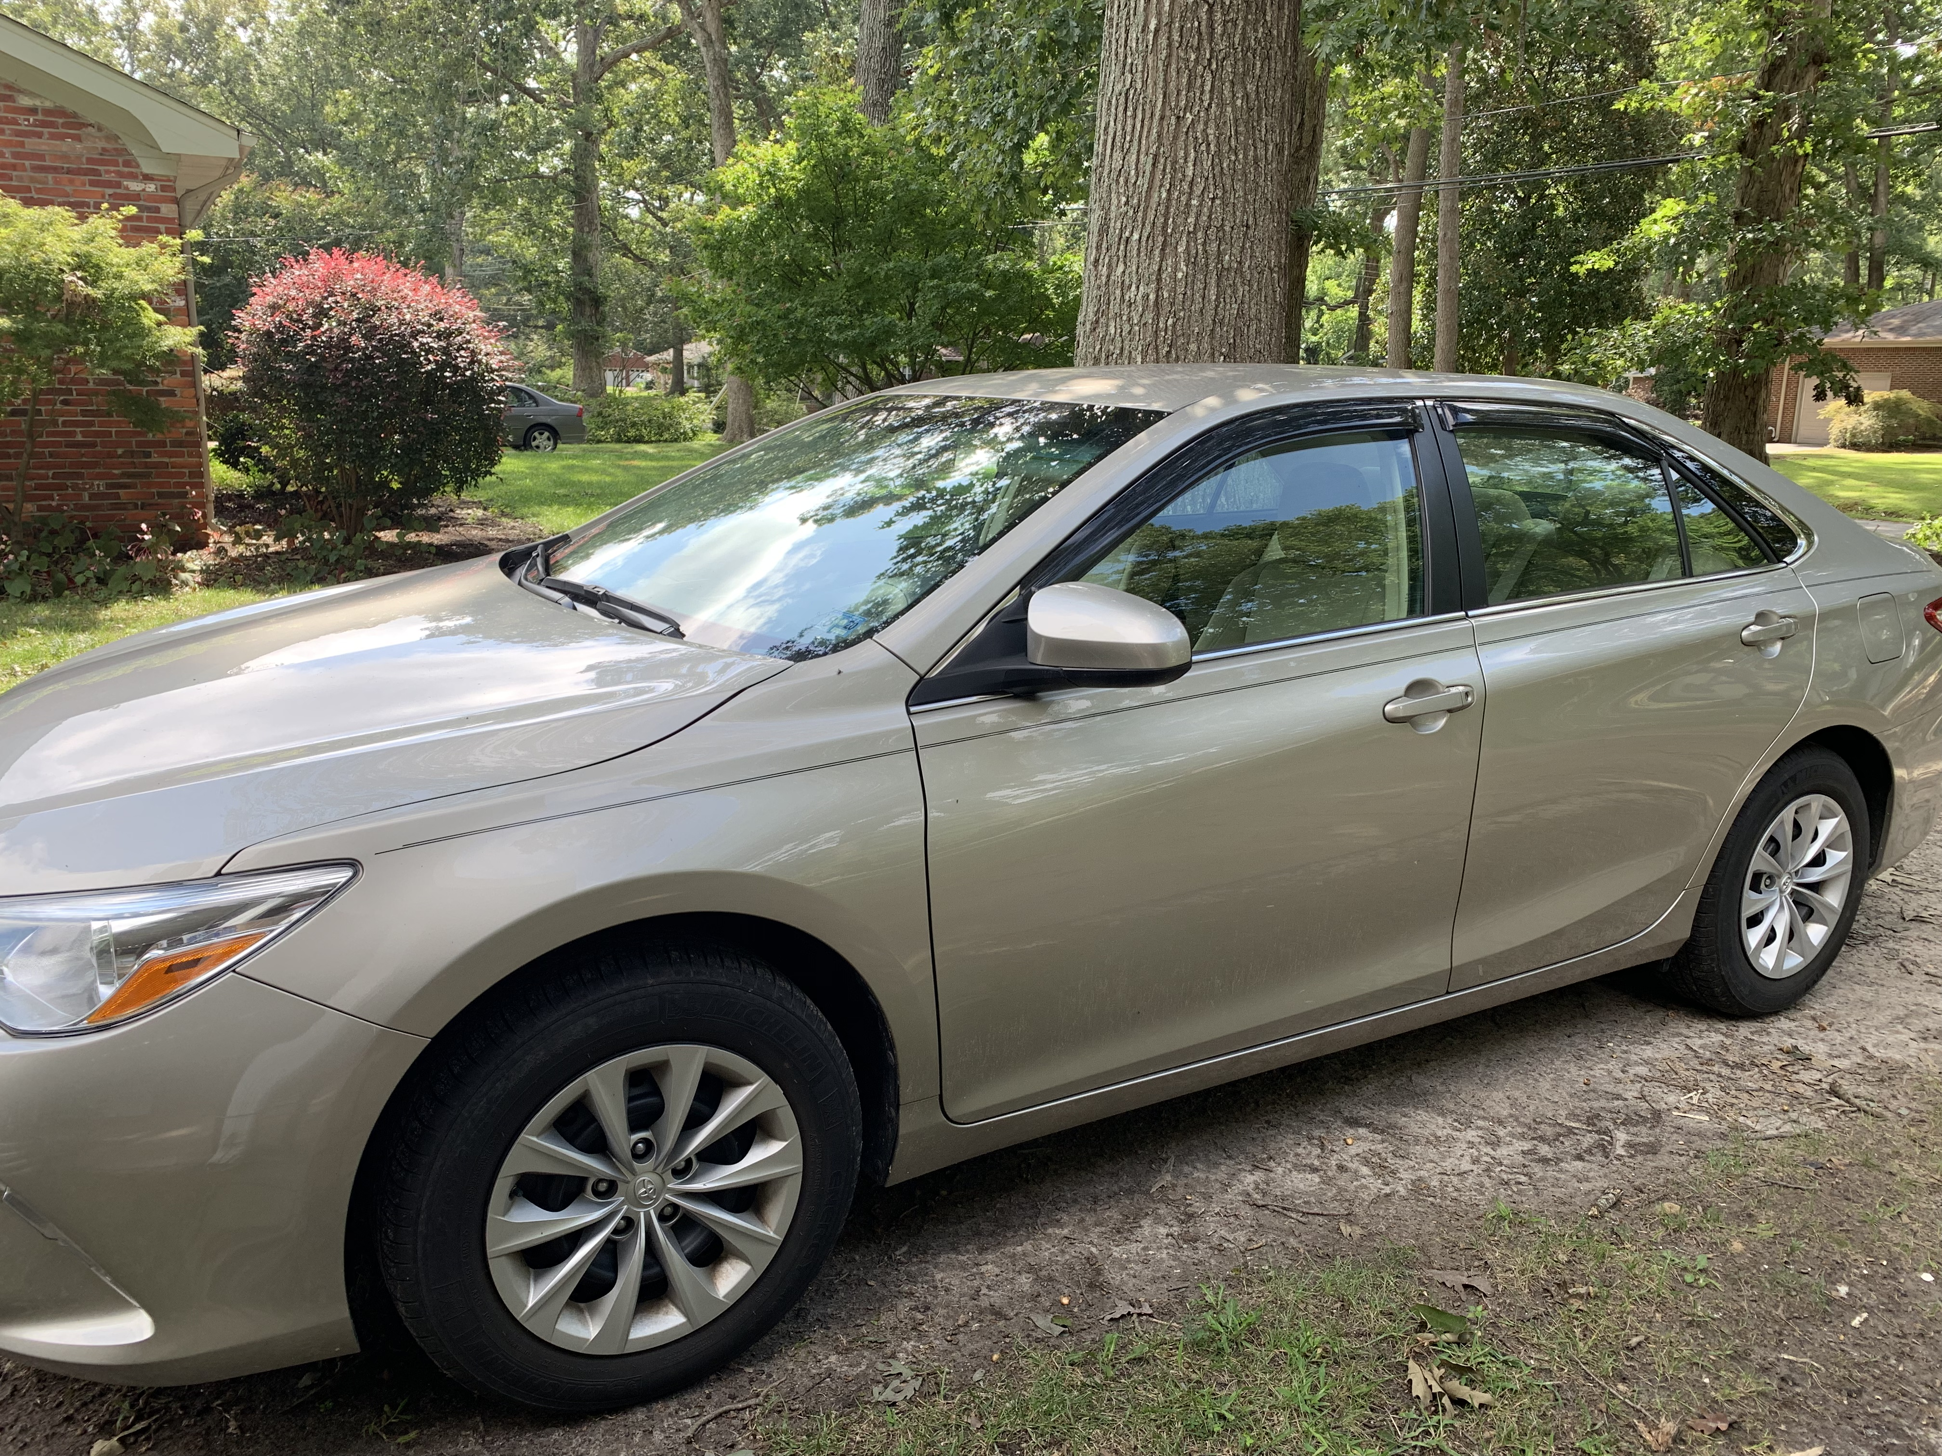
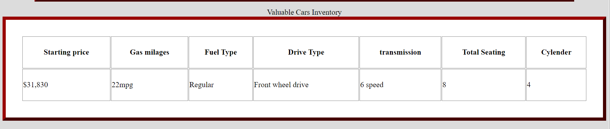
Storyboard for Sedan (Toyota Camry) page
Toyota Camry (2016)
(Sedan)
Jake Lionetti
© Photo taken by me

Slide 2
Sedan page description
Choose to use the Toyota Camry (2016 model)
Picture taken by me
Menu on the upper left (changed from previous story board)
Theme

Slide 3


Storyboard for home page
Jake Lionetti
321 Auto Street
(000)-000-0000
Contact.valuable@valuablecars.com

Slide 4
Home page description
Added a menu button for easy to use navigation
Contact information
Image carousel
Logo

